Slide 1
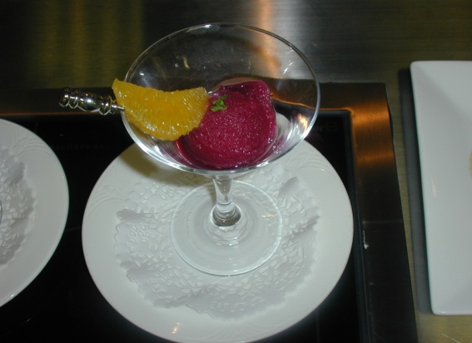
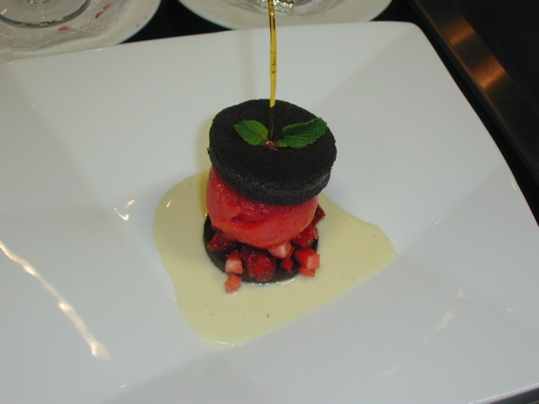
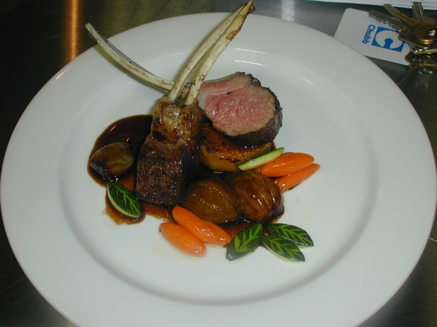
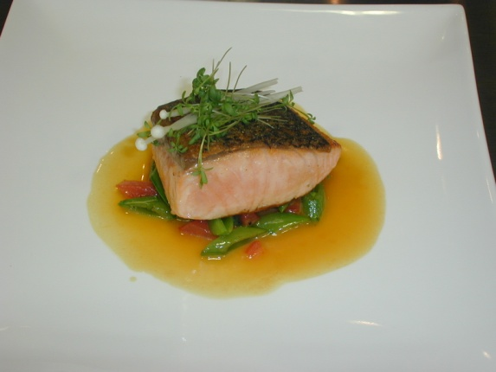
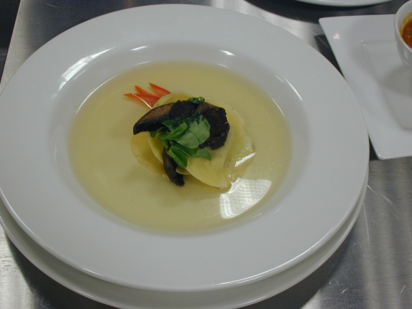
Chef de Cuisine Certification Program
Preparing for the Certification

Slide 2
Broad Strokes
The certification process:
Creates a renewed pride in our profession
Enhances respect from the public, our co-workers and our staff.
Provides a more solid foundation for the value of certification.
Provides a personal challenge and a validation of skills by peers
It is absolute proof of your knowledge and skills as a chef!

Slide 3
Some History
The Chef de Cuisine Certification Program:
Created in 1986 with a grant from the Canadian Tourism Human Resources Council
Practical Examination implemented in 1989
Theory curriculum updated in 1997
Practical examination updated in 2022
Currently 1000+ chefs have successfully completed their certification

Slide 4
The context
www.ccicc.ca
Certified Master Chef
Started in January 2011
Certified Master Chef (CMC)
Certified Master Pastry Chef (CMPC)
(Master Chef is currently being reviewed and they are looking at our model as a new platform)
Certified Executive Chef (CEC)
Certified Executive Pastry Chef (CEPC)
Personal Certified Executive Chef (PCEC)
Certified Chef de Cuisine (CCC)
Certified Working Pastry Chef (CWPC)
Certified Sous Chef (CSC)
Personal Certified Chef (PCC)
Certified Culinarian (CC)
Certified Pastry Culinarian
Trade Papers / License
Apprenticeship / Culinary Schooling
Certified Chef de Cuisine
practical exam since 1989
Certified Working Chef
First class started in March 2008
practical exam since 2003
C of Q – Red Seal
Apprenticeship / Culinary Schooling
Degree of difficulty

Slide 5
Getting Ready
Ensure you have the:
Criteria: Red Seal, 5 years post Red Seal experience, 2 years in a supervisory role, current sanitation certificate OR equivalency (foreign credentials)
Time and the personal commitment
Support of Significant Other and employer
Understanding of the program and examination process
Game plan
All details of the course content is on the website at:www.ccicc.ca

Slide 6
First Steps
Ensure CCFCC membership is current
Apply through the www.ccicc.ca website, fill in and printe the application for submission with proof of payment which is also online with PayPal.
Online is available through SAIT or NAIT
Registration with CCI - $750 ($1500 for non members). This does not include courses or exams
Determine availability of courses
Local program
Correspondence
Online under development

Slide 7
Theory Portion
Complete courses* in:
Nutrition
Human Resource Management
Menu Planning
Cost Controls
Practical workshops*
Presentation
Pastry / Baking
Practice Challenge for practical
Challenge the Theory Examination
Passing mark for all exams is 70 % and each has to be passed prior to moving forward to the next phase

Slide 8
The Practical Exam
Historically, the success rate for the practical exam averages 65%.
No one thing will cause you to fail the exam.
Problem areas leading to poor marks:
Poor sanitation
Insufficient skills displayed / Lack of practice
Untested/un-mastered recipes
Failure to deliver the menu
Failure to plan
Notes:
Like a day at work… good day… bad day….
Untested recipes – choux paste
Failure to deliver the menu
does not reflect a selling price of $45
what is written on the menu is not on the plate – scampi vs. shrimp

Slide 9
The Process – Day 1
The six course menu consisting of:
Appetizer
Soup
Fish
Salad or sorbet
Principle plate
Dessert
Notes:
Apprentice must receive 2 – 15 min. breaks and 1-30 min. eating break as per labour legislation. You do not cook them lunch. The apprentice may choose to waive his breaks.

Slide 10
The Process – Day 1
Menu Development: The candidate will prepare a six‐course menu for four (4) covers from a provided ingredient list:
Selling Price: $ 120.00
exclusive of breads and rolls, coffee, taxes, gratuities and spirits)
Desired Food Cost: 32 %
Food cost needs to fall within a ½ % variance (+ or -).
Cream will be allowed in 2 courses; 4 courses without
One of the courses must be lacto-ovo vegetarian (not the sorbet course)
Notes:
Apprentice must receive 2 – 15 min. breaks and 1-30 min. eating break as per labour legislation. You do not cook them lunch. The apprentice may choose to waive his breaks.

Slide 11
The Process – Day 1
Menu Development Con’t: Amount of food to be served:
0.900 kg to 0.965 kg (32 to 34 ounces)
Appetizer 0.120 kg (4 oz)
Soup 0.120 kg to 0.180 kg (4 to 6 oz)
Fish 0.120 kg to 0.150 kg (4 to 5 oz)
Salad or Sorbet 0.060 kg to 0.090 kg (2 to 3 oz)
Principal Plate 0.360 kg (12 oz)
Dessert 0.120 kg (4 oz)
Notes:
Apprentice must receive 2 – 15 min. breaks and 1-30 min. eating break as per labour legislation. You do not cook them lunch. The apprentice may choose to waive his breaks.

Slide 12
The Process
You must display, at minimum, the following skills:
Deboning of a poultry product
Portioning/cutting of another protein (meat).
Filleting of fish
Demonstrate a minimum of 3 precision cuts of either vegetable or potato; One (1) of which must be turned.
Notes:
No need to do anything for the Skills/Classical Menu – prepare and present
Apprentice must receive 2 – 15 min. breaks and 1-30 min. eating break as per labour legislation. You do not cook them lunch. The apprentice may choose to waive his breaks.

Slide 13
The Process
Display Skills, Con’t:
Principal plate to demonstrate 3 different cooking methods, one of which must be braised (meat, poultry or vegetable).
Notes:
For the purpose of this exam a confit will be considered braising
Precision controlled equipment (e.g. Sous Vide, Thermo Mixer) can only be utilized once during the menu preparation, but not for the principle plate.
Notes:
No need to do anything for the Skills/Classical Menu – prepare and present
Apprentice must receive 2 – 15 min. breaks and 1-30 min. eating break as per labour legislation. You do not cook them lunch. The apprentice may choose to waive his breaks.

Slide 14
The Process
Display Skills, Con’t:
A forcemeat.
A butter sauce (emulsified)
A thickened sauce (not corn starch)
A minimum of 4 different vegetable preparations over the 6 courses
A minimum of 3 different starch presentations over the 6 courses
Notes:
No need to do anything for the Skills/Classical Menu – prepare and present
Apprentice must receive 2 – 15 min. breaks and 1-30 min. eating break as per labour legislation. You do not cook them lunch. The apprentice may choose to waive his breaks.

Slide 15
The Process
Display Skills, Con’t:
Appropriate presentation techniques (including functional garnishes) for all courses must be based on contemporary culinary and gastronomic rules.
Must include an edible functional garnish that adds to the presentation of the dish (visual, texture, and flavour).
Demonstrate a fabricated style garnish for a minimum of 2 of the courses.
Notes:
No need to do anything for the Skills/Classical Menu – prepare and present
Apprentice must receive 2 – 15 min. breaks and 1-30 min. eating break as per labour legislation. You do not cook them lunch. The apprentice may choose to waive his breaks.

Slide 16
The Process
Display Skills, Con’t:
Demonstrate piping skills – with piping bag or paper coronet
Dessert to have at minimum the following components;
a pastry and/or cake,
a custard,
a prepared fruit component (not a berry garnish)
a minimum of 1 (one) sauce,
A garnish of either sugar (including rolled fondant or pastillage) or chocolate
Notes:
No need to do anything for the Skills/Classical Menu – prepare and present
Apprentice must receive 2 – 15 min. breaks and 1-30 min. eating break as per labour legislation. You do not cook them lunch. The apprentice may choose to waive his breaks.

Slide 17
The Process
Display Skills, Con’t:
The candidate is allowed to bring in one ingredient (raw ingredient, not a prepared item) that is not on the list if they choose. The ingredient must be written into the standard recipes and costed at a fair market value.
Note: The menu, standard recipes and requisitions must pass with 70% in order to proceed to Day 2 (Practical testing)
Notes:
No need to do anything for the Skills/Classical Menu – prepare and present
Apprentice must receive 2 – 15 min. breaks and 1-30 min. eating break as per labour legislation. You do not cook them lunch. The apprentice may choose to waive his breaks.

Slide 18
The Process
Evaluation of menu and recipes
First your menu must pass scrutiny of the examiners
Only then will your recipes and requisitions be evaluated and marked.
Passing mark for this stage is again is 70%
FYI menus, recipes and requisitions are meticulously checked for accuracy, spelling and neatness. If it cannot be read it cannot be marked.
Laptops or PCs are required. MS Word and MS Excel format only when submitted electronically
Notes:
No need to do anything for the Skills/Classical Menu – prepare and present
Apprentice must receive 2 – 15 min. breaks and 1-30 min. eating break as per labour legislation. You do not cook them lunch. The apprentice may choose to waive his breaks.

Slide 19
Example of Practical Day 2
7:00 am – Meet
7:30 am – Introduction to Apprentice
8:00 am – Begin in kitchen
9:30 am – Submit “short” list
1:30 pm – Menu presentation begins
1:30 pm – 1st course
1:50 pm – 2nd course
2:10 pm – 3rd course
2:30 pm – 4th course
2:50 pm – 5th course
3:10 pm – 6th course
3:30 pm – Individual debriefing of apprentices and candidates
Notes:
You will not receive a pass/fail on the day. It will be mailed with a synopsis within 10 business days.

Slide 20
Notes
Each Candidate is examined by 3 chef-examiners/invigilators
Chef-examiners have passed all segments of the program with a minimum of 80% or have the “Certified Master Chef” designation and have practice examined at least twice
Examination is done at an “arm’s length”
References for classical dishes:
Larousse Gastronomique
Le Guide Culinaire
Le Repetoire
Herring’s
Notes:
Arms length
as examiners we all want to see success, but we are entrusted with maintaining the standards of the program.
Chefs uniforms to have no names – you are a candidate number only – this ensure anonymity. You will not be examined by anyone you know.
Variations in classical dishes – “galette potatoes” – as long as verified by one of these references.
Apprentices – no ringers.

Slide 21
Notes
Assistant is someone you will not know
Entitled to 2 x 15 min breaks and 1 x 30 min eating period
The assistant will be supplied by the testing site and will be a 2nd year culinary student in good standing
Chef’s Uniform can not have a name or logo displayed, the same applies to China if brought in by the Candidate
Notes:
Arms length
as examiners we all want to see success, but we are entrusted with maintaining the standards of the program.
Chefs uniforms to have no names – you are a candidate number only – this ensure anonymity. You will not be examined by anyone you know.
Variations in classical dishes – “galette potatoes” – as long as verified by one of these references.
Apprentices – no ringers.

Slide 22
Evaluation/Marking
Kitchen Marking (1/2) of final mark)
25% Application of Technical Skills
20% Mise-en-place and Organization
10% Communication and Use of Apprentice
25% Sanitation and Cleanliness of Workstation
10% Waste and Product Handling
5% Use of Equipment
5% Professionalism
Notes:
Use of Apprentice:
You are encouraged to teach/train the apprentice. Eg: you demo 2 lamb racks – he does 2
You are not penalized for the apprentices mistakes if teaching a skill.
Penalized if given a routine task eg: julienne – not to spec
No garbage pails – 2 trays – one for garbage, on for recyclable garbage – bones, peelings, compost
Professionalism – conduct, appearance, safety

Slide 23
Evaluation/Marking
Six Course Menu (1/2 of final mark)
10% Timing
On Time within a 2 minute window (0 to 2 min.) = 10
Up to 1 minute late (2 to 3 minutes) = 8.5
1 to 2 minutes late (3 to 4 minutes) = 7
2 to 3 minutes late (4 to 5 minutes) = 5.5
3+ minutes late (5+ minutes) = 0
40% Presentation

Slide 24
Evaluation/Marking
Six Course Menu (Con’t)
10% Temperature
Properly hot or cold (appropriate temperature for service) = 10
Adequately hot or cold (above 140F/60C or below 40F/4C) = 7
Improperly hot or cold (between 140F/60C and 40F/4C) = 0
40% Taste and Texture

Slide 25
Things to watch for
Butchery is always first
Use the correct knife for the job
2 spoon method for tasting
3 bowl method for separating eggs
S.S Whisk in aluminum pot
Toolbox on worktable
Dropping side towel on floor and continuing to use
Food left out on work table
Disorganized work station
Disorganized refrigerator
Boiling
Browning bones and mirepoix simultaneously
Wooden spoons in simmering pots
Not sanitizing cutting board or knives between uses

Slide 26
Presentation
Use of herbs for garnish
Presentation of plates
Classical dishes
Contemporary dishes
“Dirty” plate presentation
Lets look at some examples…..
Notes:
Only use the herb if it is used in the cooking of the dish
Contemporary presentation is acceptable for classical dishes except those in which the presentation is intrinsic to the dish
fillets of sole ‘bonne femme’ – not paupiettes, sauce underneath – NEVER LEMON WITH A SAUCED FISH
crème caramel
braised lettuce – flat, square packets, knapped with a light jus from the braising liquid
Presentation of your plates is at your discretion, though presentation that is “au courant” is what is looked for.
“Dirty” plate presentation – suggest only for dessert.

Slide 27
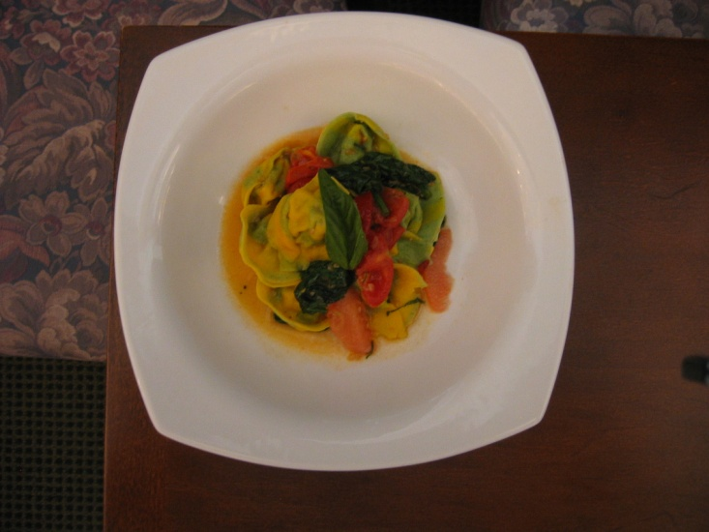
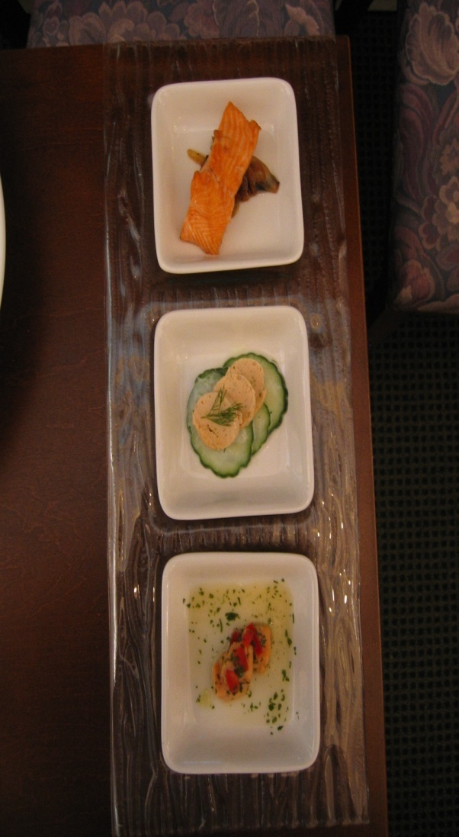
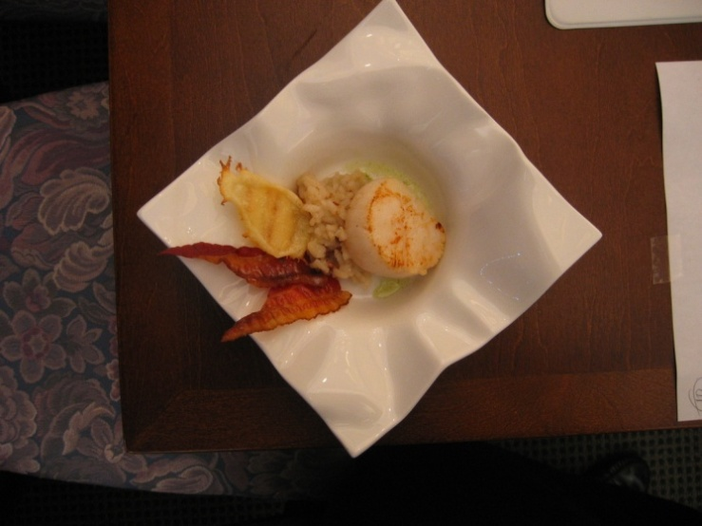
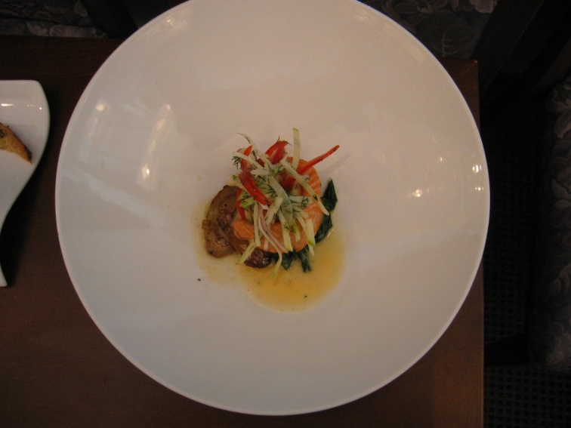
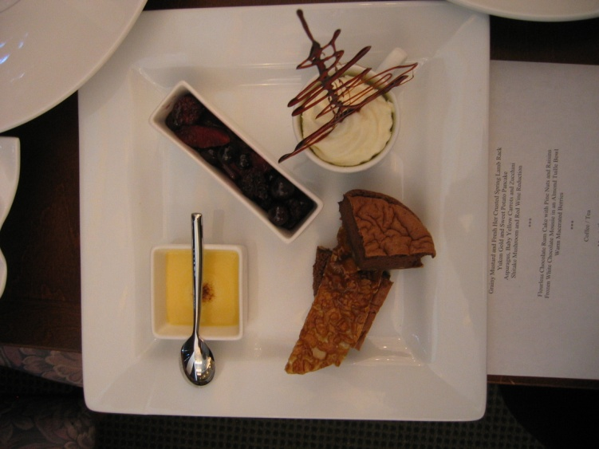
What it should look like

Slide 28
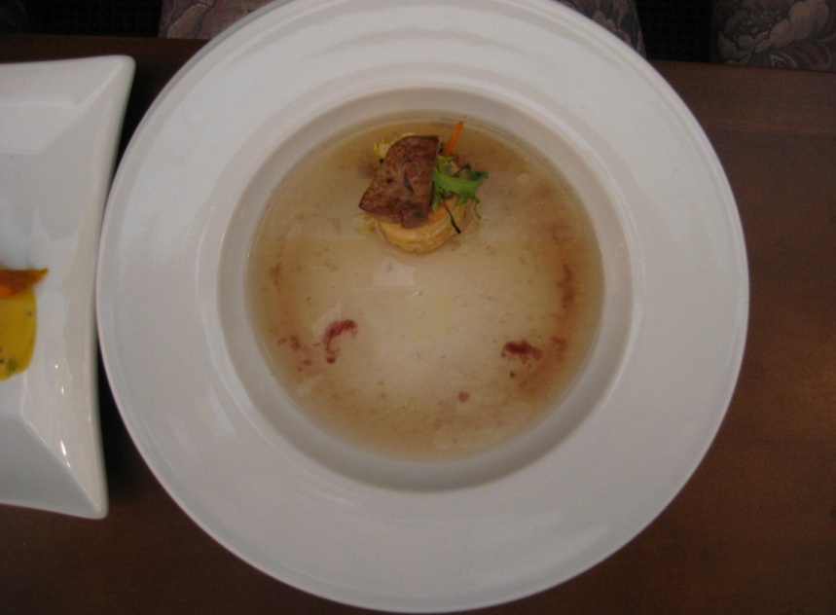
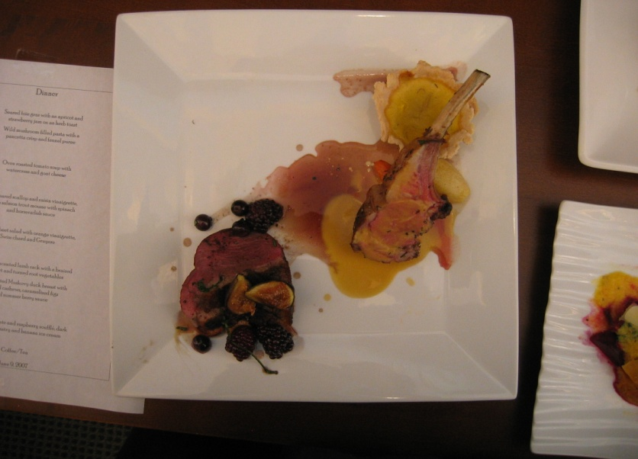
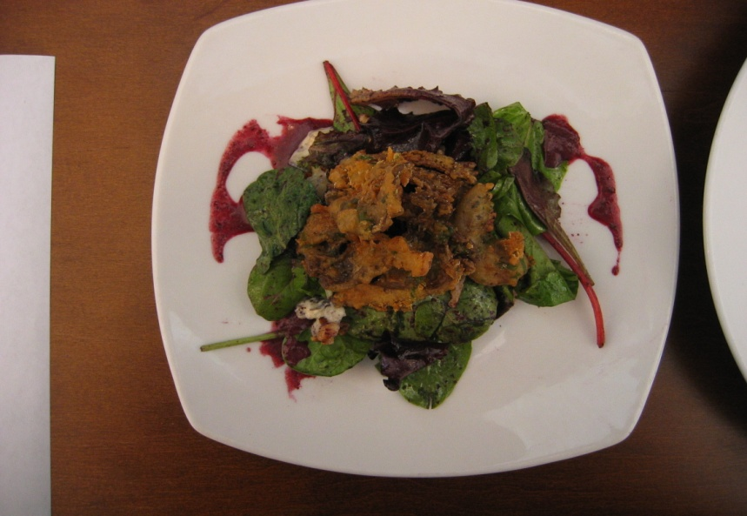
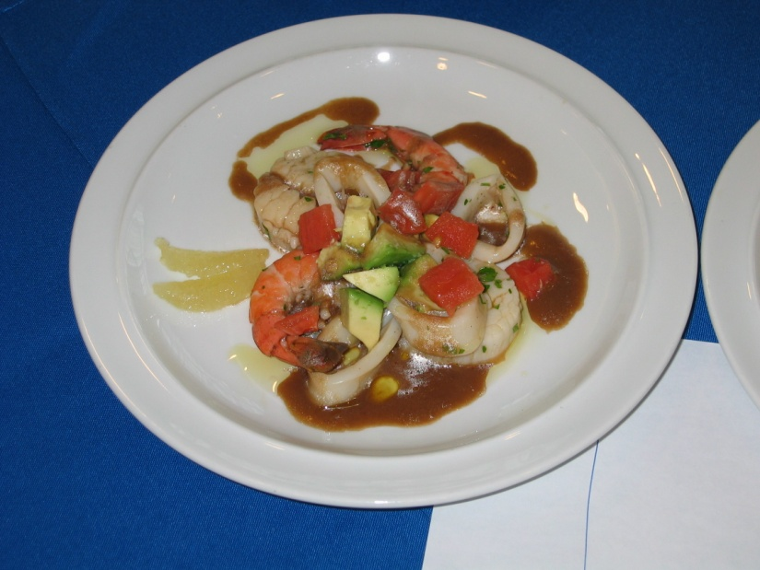
What it should not look like

Slide 29
Guaranteed to Happen
The exam is fraught with complications. Things will go wrong.
Everyone else will seem to be working faster, with less problems, and be farther ahead
Be prepared for examiners to look into your ovens, pots and pans, fridge, watch you de-bone or fillet, then walk away and write in their books.
Examiners will ask your apprentice what you are preparing and what his/her task is, then walk away and write in their books.
Examiners will stand and watch your consommé boil over, you caramel burn, etc , then walk away and write in their books.

Slide 30
Set yourself up for success
Properly attired
Toque Blanche or black pillbox, white chef jacket (no name or logo), black pants, white or black apron, necktie, black leather shoes or enclosed clogs, hair off the collar, jewelry/watches/earrings removed (plain gold wedding band is the only exception)
Sharp Knives
Extra side towels and apron
Cloths for wiping/sanitizing
Latex (Vinyl) gloves, plastic tasting spoons, zip-loc bags
Pastry recipes allowed
Specialty Equipment
Plan the work – work the plan. Fail to plan – plan to fail.
Notes:
These are suggestions.
Specialty equipment that you bring in becomes common to all candidates.
Failure to plan is a plan for failure

Slide 31
Q and A
Questions, comments or concerns?
Steven Benns, B Comm, CCC
CCI National Chair
www.ccicc.ca
cci@culinaryfederation.ca
steven.benns@flemingcollege.ca
Tel: 705 749-5530 ext. 1235

